Slide 1
corporate web access booking tool

Slide 2
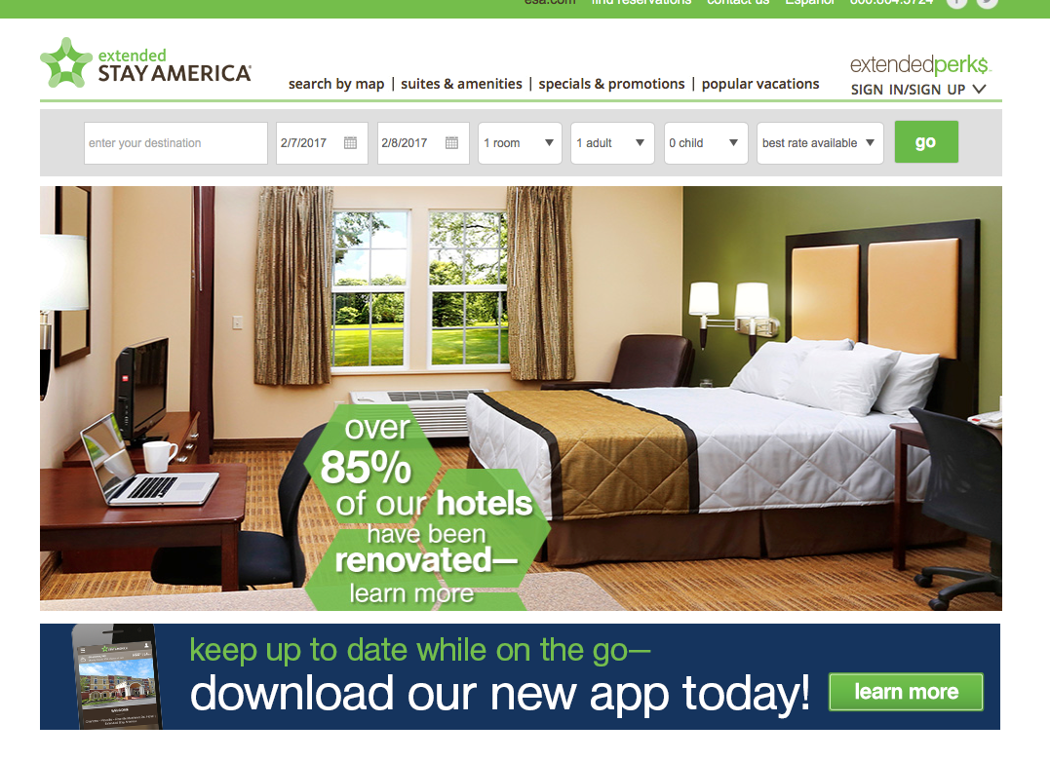
go to www.esa.com/extendedperks
1. sign up for our Extended Perks so you can manage your profile and see past reservations
2. Once you are signed up, make sure you are logged in before booking using your web code

Slide 3
enter the stay details
select the city/state, airport, attraction, or address of your destination
select check-in and check-out dates
enter the number of rooms/guests

Slide 4
enter your corporate web code
under special rates, select corporate
enter the corporate web code assigned to your account (EAAAP)
click on find hotels

Slide 5
select a hotel
all available Extended Stay America hotels in the area will be displayed – sorted by distance from the location you entered (typically city center)
hotels can also be viewed on a map by clicking the “MAP” tab
select the hotel you want from the list displayed

Slide 6
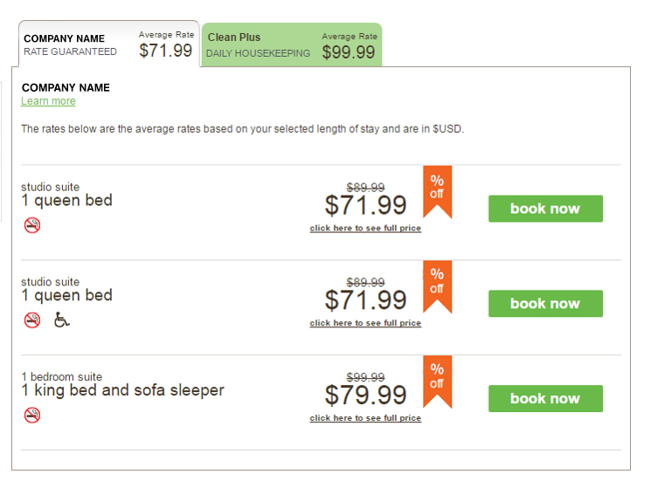
select the room type you want
view the full room price, including tax, by clicking on the link below the rate
click book now to select your room

Slide 7
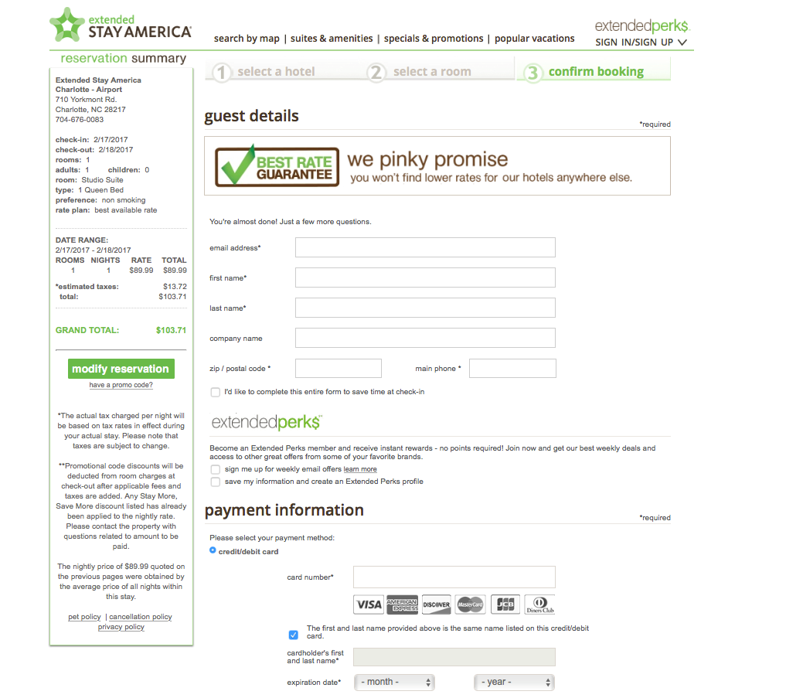
complete the guest details
option to include travel agency information
option to pay by credit card or input direct bill account number
option to add in any special requests or comments
option to forward confirmation to additional email addresses

Slide 8
your confirmation is on the way!
your confirmation will be sent to the email address you provide
your ease of booking just became EXTENDED!

Slide 9
need further assistance?
no problem!
contact your ESA Account Representative who will be eager to assist you!
Account Services Coordinators
980.345.1555
core@esa.com

